Slide 1
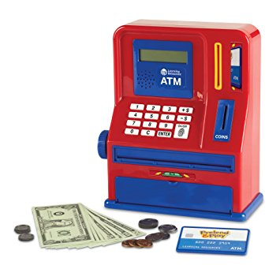
ATM Project
NEEDS MORE WORD ART
Mary Husain | Michal Porubcin | Andrew Quijano | Bryce Yoo
Notes:
Mary Husain
Michal Porubcin
Andrew Quijano
Bryce Yoo

Slide 2
Overview
Core Functionality
User Interface
Encryption
Database
Online ATM
User Accounts
Tools & Services
Paragraph (if not needed, delete)
Bullet
Dash
Subbullet
Paragraph (if not needed, delete)
Bullet
Dash
Subbullet
Paragraph (if not needed, delete)
Bullet
Dash
Subbullet

Slide 3
Core Functionality
User Accounts
First Name
Last Name
PIN Code
Account Balance
Services
Withdrawals
Multiples of $20
Quick withdrawal options from $20 - $100
Manual for amounts larger than $100
Deposits
Any positive amount (minimum $0.01)

Slide 4
User Interface

Slide 5
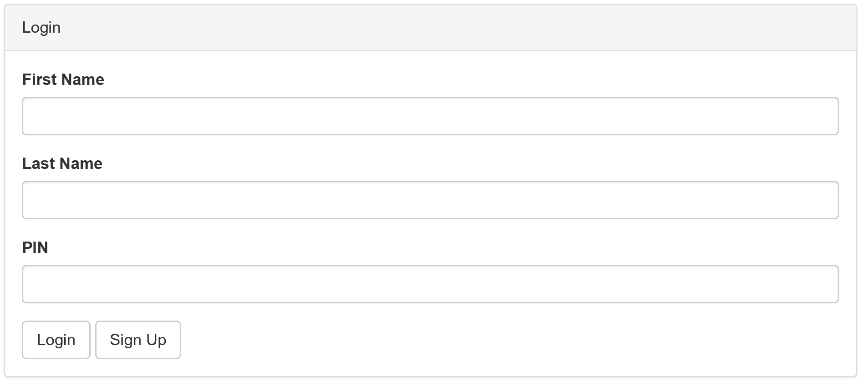
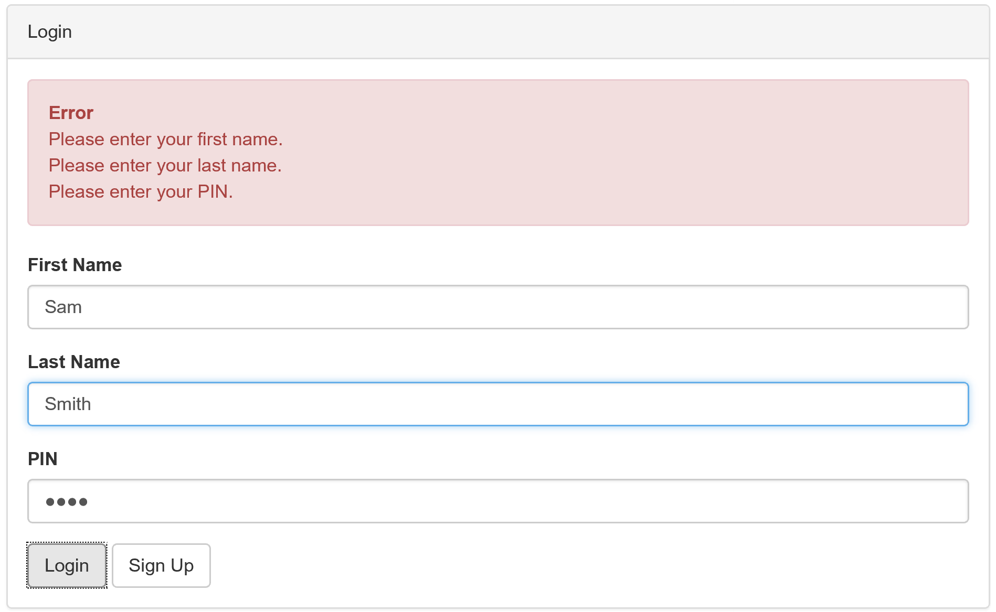
Login Screen and Validation

Slide 6
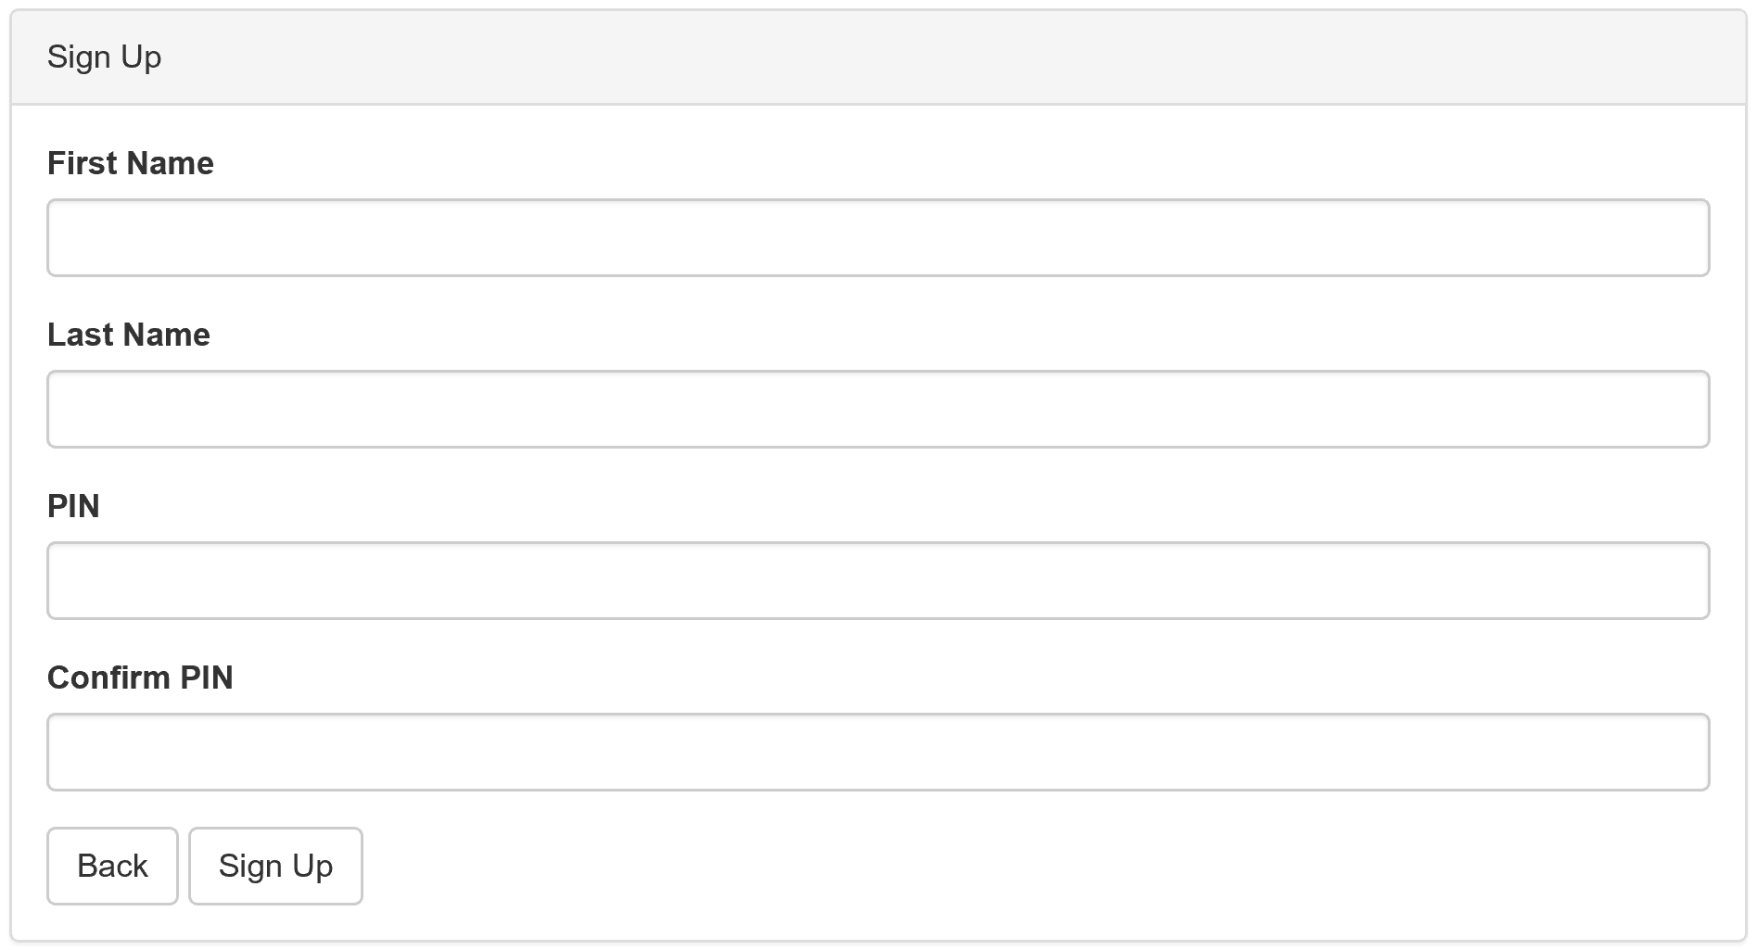
Sign Up Screen

Slide 7
Encryption Background
Symmetric-Key Encryption (e.g. AES)
Reversible
Useless in case of hacked DB
Hash function (e.g. RSA, Blowfish)
Irreversible
Reduce effectivity of brute force attacks
Blowfish > RSA:
Add salt to protect against Rainbow Tables (pre-computed hashes)
Bcrypt
Easy Blowfish package for C#
Obtained with Nuget

Slide 8
Encryption and Security
Client
User inserts PIN
Client hashes the PIN using Blowfish algorithm (with salt)
Client sends [Hashed PIN + salt] to server
Server
Signup: Server stores [Hashed PIN + salt] in database.
Login: Server verifies Hashed PIN against value in database.

Slide 9
Database

Slide 10
Further Potential

